Slide 1
AirBnB Data Analysis
By – Nitisha Tyagi

Slide 2

Business Understanding
By studying the data given we need to reveal insights into user experiences and satisfaction levels with the numerous listed stays

Slide 3
Data Understanding
The data that is available provides us with total listings ,locations of listing, host details, user experience, rating and reviews.

Slide 4

Data Preparation
Challenges faced during Preparation
Filling the empty values with average ratings for all the ratings given
Filling the empty values of superhost with f based on mean value .
Changing the type of price column to make it in currency

Slide 5
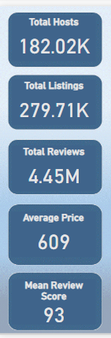


Data Insights

Slide 6
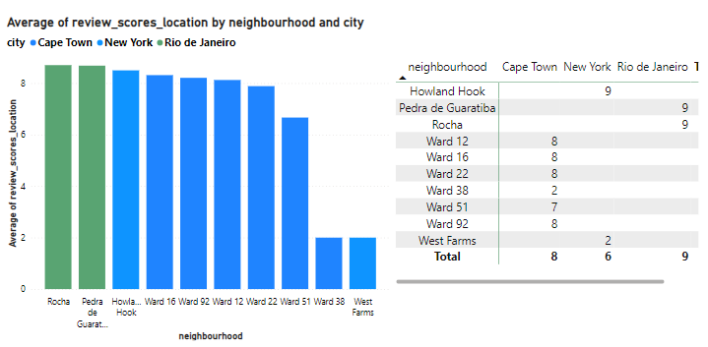
Assessing District Location Scores

Slide 7
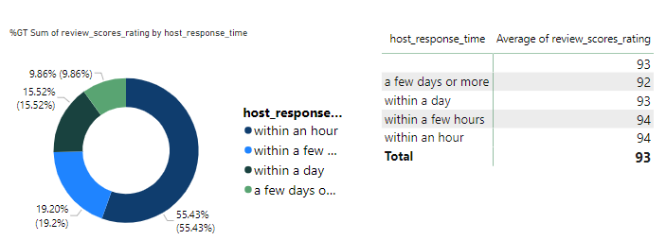
Examining Host Response Time Impact

Slide 8
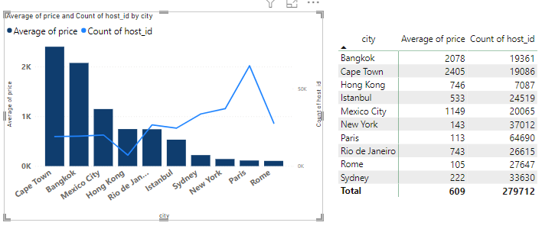
Visualizing Airbnb Listing Prices

Slide 9
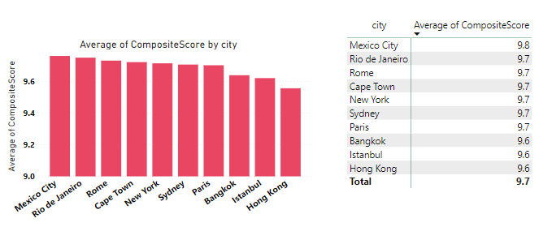
Analyzing Composite Scores:

Slide 10
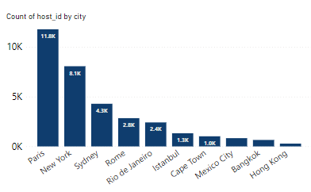
Listing Age and Host Tenure

Slide 11
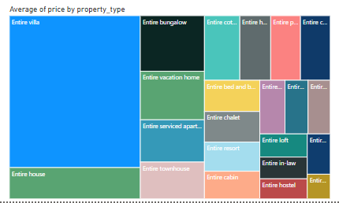
Property Type Price Analysis:

Slide 12
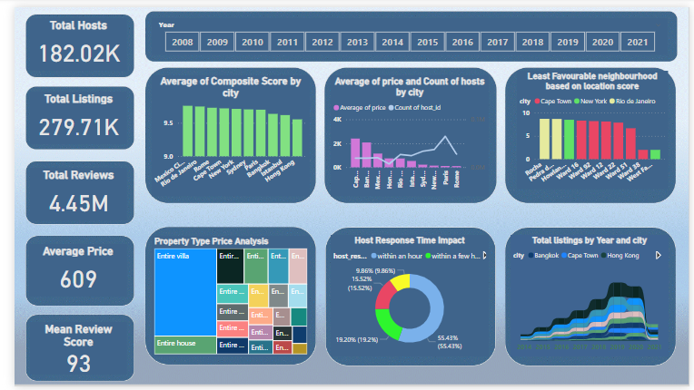
Comprehensive City Insights Report:

Slide 13
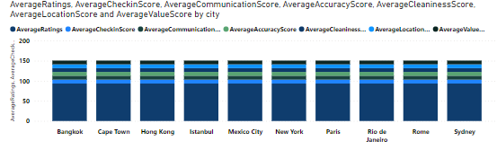
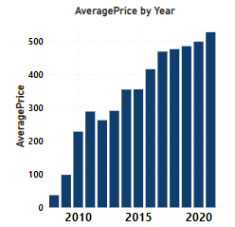
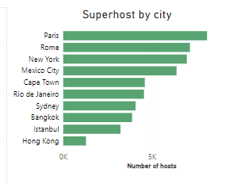
Few other Insights

Slide 14
THANK YOU

